Slide 1
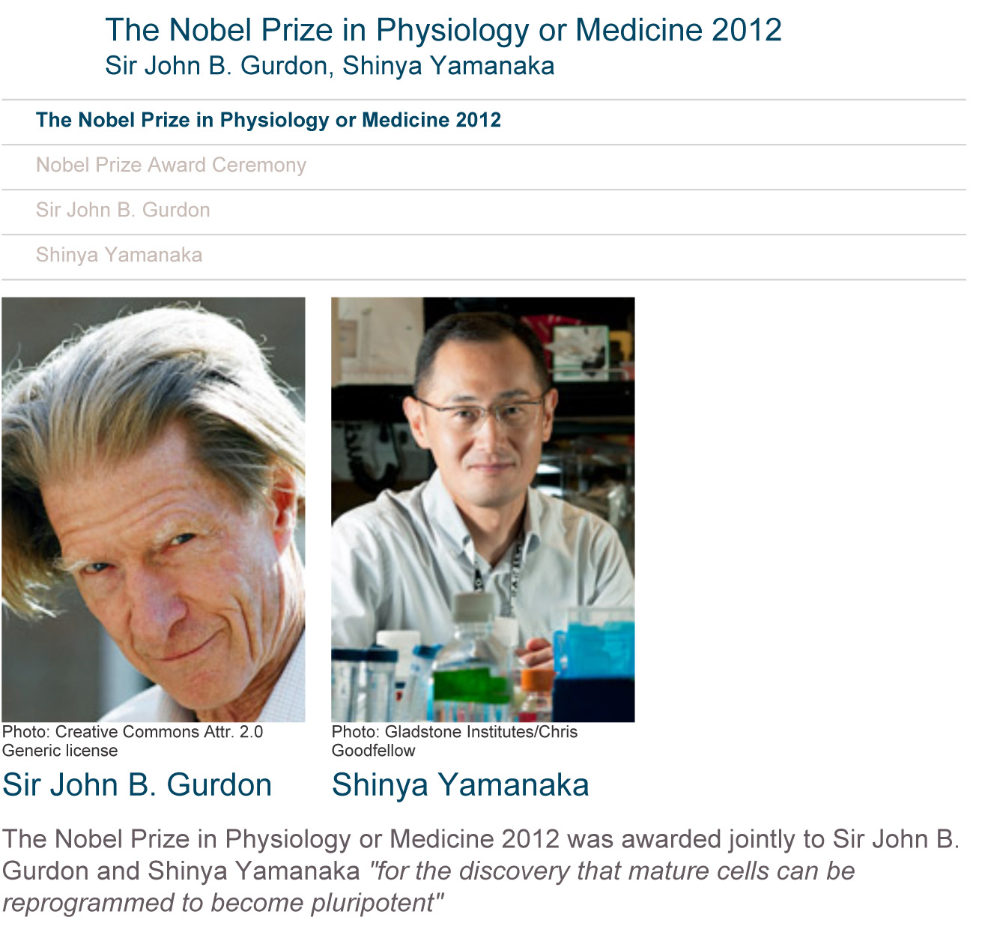

Slide 2
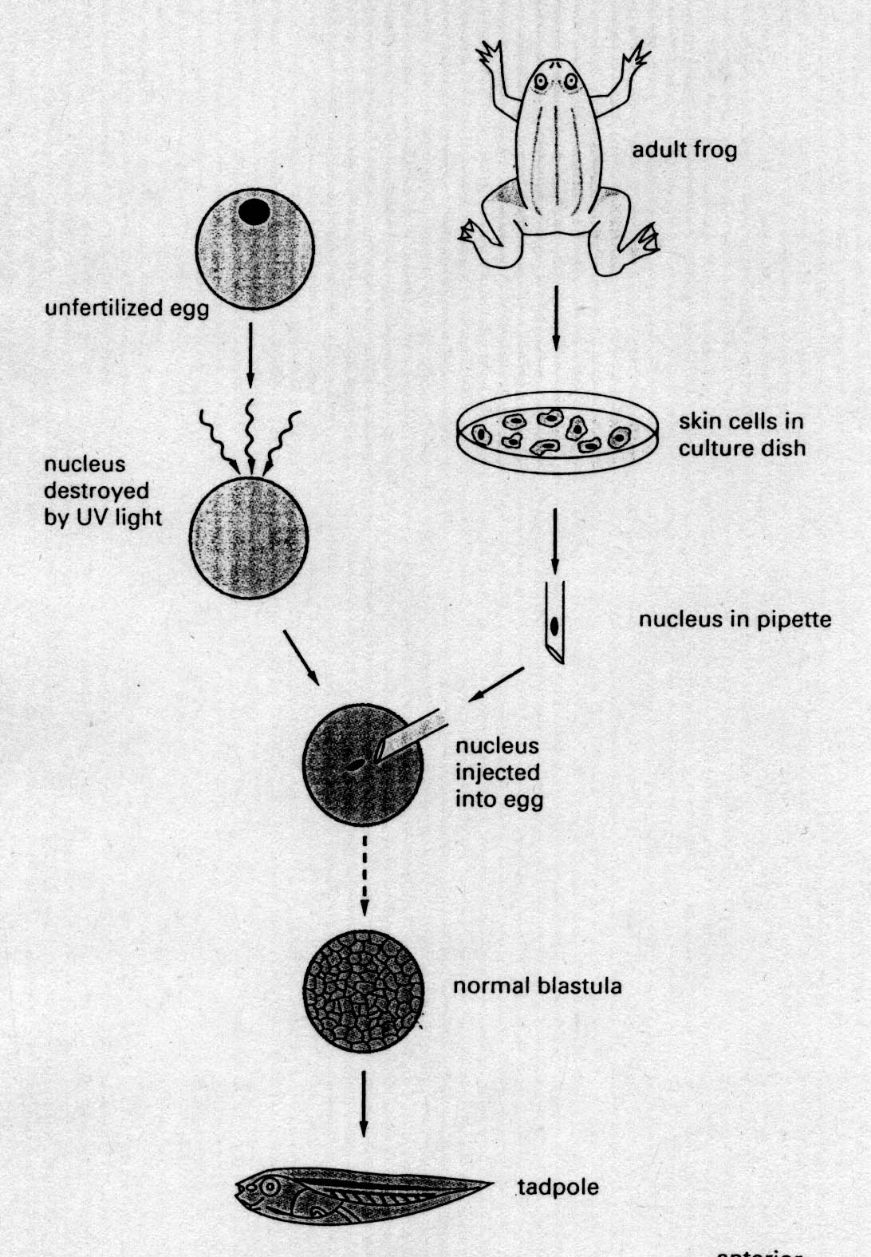
Transplantation experiment
John Gurdon

Slide 3
What was the major goal of this paper?
It is possible to use goats to clone lamb
Investigate whether cellular differentiation in animal development involves irreversible genetic modifications
To demonstrate that the nucleus from cells of the adult mammary gland can be used to clone lamb.
To determine if the nucleus or the cytoplasm is more important for shaping the morphological characteristics.
All of the above.

Slide 4
What was the major accomplishment of this paper that had not been achieved previously by others?
The authors developed an efficient and successful nuclear transfer technique
The authors demonstrated successful lamb cloning using three different populations of cells.
The authors were the first to obtain a fully developed mammal from a cell derived from an adult tissue.
The success rate of cloning was significantly higher than previous nuclear transfer experiments
None of the above

Slide 5
Why in Fig. 2 the cloned lamb looks different from the recipient ewe?
A. It is due to the natural variations of the animals
B. It is because the transplanted nucleus determines the look of the cloned lamb.
C. It is because the enucleated unfertilized egg used determines the look of the cloned lamb.
D. It is the hybrid appearance determined by both the donor nucleus and the enucleated unfertilized egg

Slide 6
What are your major criticisms of this paper if you were a reviewer
A. The success rate was a bit too low ( < 6%)
B. I want to see at least one more successful cloning derived from cells of adult mammary epithelium.
C. I don’t think this is a significant advance over the Xenopus experiments performed by Sir Gurdon.
D. I want to see the authors obtain successful cloning using cells from a different adult tissue (e.g. intestine cells).
E. I am so impressed by this paper that I fully endorse its publication in Nature.

Slide 7
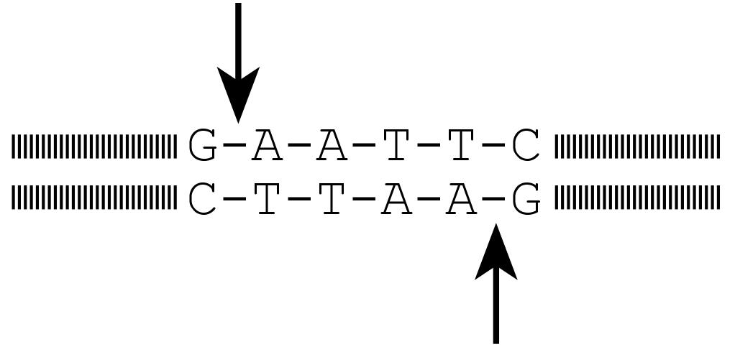
Restriction enzymes
Restriction Enzymes: E.g., EcoR1
G-A-A-T-C-C
C-T-T-A-G-G
Can’t be digested by EcoR1

Slide 8
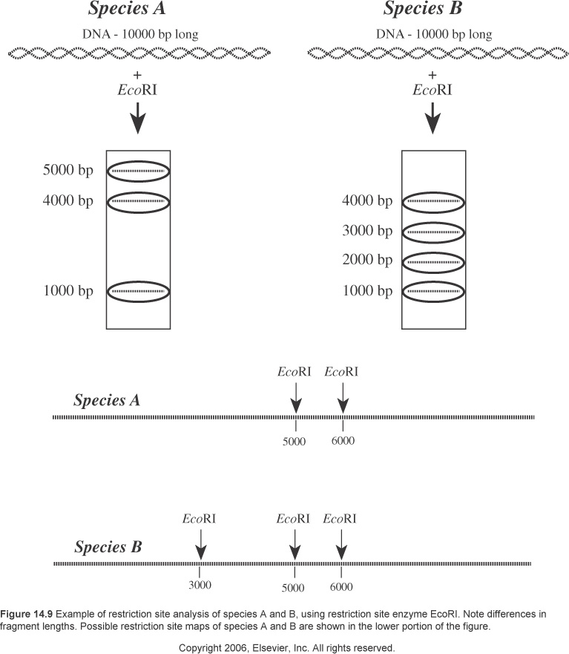
RFLP: Restriction Fragment Length Polymorphism

Slide 9
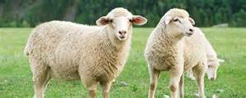
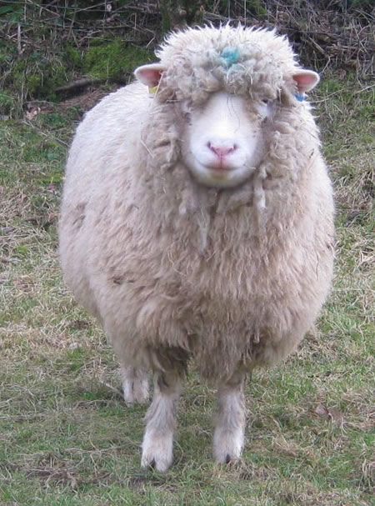
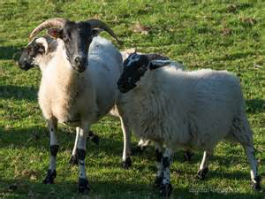
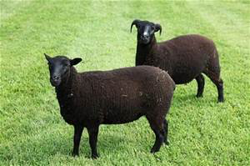
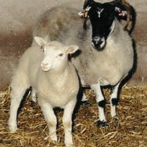
Finn Dorset
Scottish blackface
Poll Dorset
black welsh
Cloned lamb

